Slide 1
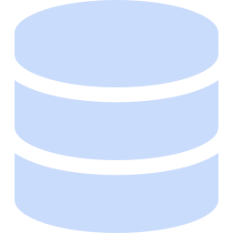
OLIST E-COMMERCE DATA PIPELINE
Architecture & Design Rationale
Why we built it this way — and why not another way
Module 2 Assignment | Belina | Hui Min | Nivedha | Rupa | Yeh Yuen

Slide 2



BUSINESS VALUE
What This Replaces: 4 Questions, Answered Consistently
What product categories drive revenue?
Which regions drive revenue?
The base trajectory metric executives ask about first — frames every other finding.
How do holidays change demand?
Turns an operational metric into a quantified revenue risk.
Which customers matter most?
Separates one-time buyers from customers worth investing in.
Today, each of these needs a fresh, one-off pull. This pipeline answers all four the same way, every time — no re-deriving the numbers.
3

Slide 3



EXECUTIVE SUMMARY
One Pipeline, Answering the Same four Questions Every Time
11 → 1
$0
4
raw tables unified into one trustworthy source
infrastructure cost, by design — not by luck
recurring business questions, answered on demand
We replaced ad hoc, one-off data pulls with a governed, automated pipeline that turns Olist's raw order data into the answers leadership asks for every month — built in two weeks, at zero infrastructure cost.
2

Slide 4
KEY FINDINGS
What the Pipeline Already Shows
Real findings from the analysis layer — not a hypothetical value story.
Fastest growing products?
Highest changes in daily sales around holidays?
+6,433 in sales
+428,933 in sales
.Watches & Gifts had highest positive revenue change from 2017 to 2018
CORPUS CHRISTI had the largest daily sale changes with the product category - watches_gifts
This is the kind of insight the pipeline surfaces every month automatically, not from a one-off analysis. It also validates the optional holiday-API enrichment from Section 1 — the effect it was built to detect is real and measurable.
10

Slide 5






TECHNICAL OVERVIEW
Architecture at a Glance
Kaggle CSVs
9 raw source files
Meltano
BigQuery
dbt
Tests
Analysis
Holiday API
REST API, BrasilAPI
extract & load
raw layer, 1:1 mirror
builds star schema
dbt + Great Expectations
SQLAlchemy + pandas + CSV + Matplotlib/Streamlit
Github Actions orchestrate the pipeline from data ingestion to data validation
4

Slide 6
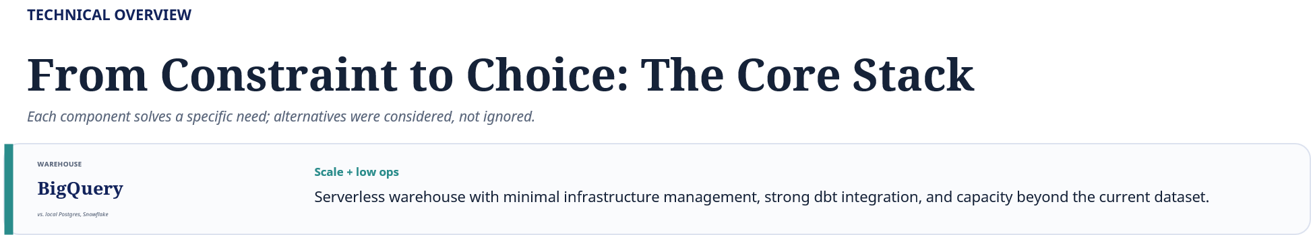

Slide 7

TECHNICAL OVERVIEW
The Same Constraint, Applied to What We Excluded
Apache Spark
Kafka
DuckDB
Distributes computation across a cluster when data exceeds one machine's capacity.
Consumes a live, continuous event stream.
Runs fast, in-memory SQL analytics outside the warehouse.
50-100MB total, well below the threshold for distributed computation. BigQuery already runs our transforms as distributed SQL — a second engine here solves nothing new.
A static historical export, not a live feed. Simulating a stream that doesn't exist would be artificial, not useful engineering.
pandas alone handles this data volume without strain. DuckDB solves a memory and speed problem this dataset doesn't have — a second query engine for capability we don't need.
Cost & complexity, again: same reasoning applied three times, not stretched to fit.
7

Slide 8
TECHNICAL OVERVIEW
Transformation & Modeling
INTERMEDIATE
ANALYTICAL MODEL
RAW
STAGING
ANALYTICAL MODEL
VALIDATED BUSINESS DATA
Ingest raw JSON/CSV data from APIs and relational sources directly into the storage layer
Standardize data
Consistent data types and naming
Enrich data
Normalize source data
Combine related datasets
Add business attributes
Apply business logic
Derive analytical fields
Model
Define clear fact-table grains
Build reusable dimensions
Implement star schema
Add surrogate keys for analytical relationships
Build fact tables
Build reusable dimensions
Implement star schema
Add surrogate keys for analytical relationships
Validate
Uniqueness
Not-null checks
Referential integrity
Accepted-value checks
Business-rule validation
Raw data is transformed into a governed analytical model with consistent business definitions, enabling trusted reporting and scalable analytics.
7

Slide 9
TECHNICAL OVERVIEW
Data Warehouse Star Schema
dim_date
fact_payments
dim_customer
fact_orders
fact_reviews
dim_geolocation
fact_order_items
dim_seller
fct_customer_rfm
dim_product
dim_geolocation
8

Slide 10


TECHNICAL OVERVIEW
Two Tools, Two Different Jobs — Not One Job Twice
dbt and Great Expectations are both used because they test different things, not the same thing.
dbt: deterministic correctness
Great Expectations: business realism
Is the data structurally sound?
Every key present and unique
Every reference resolves, every value valid
Row counts stay correct through every join, staging → marts
i.e. every order item belongs to a real order in fact_orders
Do the values make sense?
Values fall in a believable range
Events happen in the right order
Data stays complete and consistent over time
i.e. review scores between 1–5, delivery date after purchase date
Already caught, from profiling the real data before any model was built:
261,831
303
814
exact duplicate geolocation rows, now aggregated before joining (i.e. one row per ZIP before the mart join)
orders where payment total didn't match price plus freight
repeated review_id values — the real grain needed a second key (i.e. review_id, order_id)
Critical failures block the pipeline; known source quirks are logged as observations, not silent surprises at report time.
9

Slide 11
TECHNICAL OVERVIEW
Blocking vs. Watching: How Failures Actually Get Handled
Not every data issue should stop the pipeline — critical errors block, known quirks get logged.
Meltano
dbt
dbt marts
GX checkpoint
Orchestrator
loads raw tables
staging + structural tests
grain + reconciliation
critical + observation
halts on critical failure
CRITICAL — Blocks the Pipeline
OBSERVATION — Logged, Not Blocking
A negative price, a broken foreign key, a review score outside 1–5.
623 products missing a category — a known source limitation.
Pipeline halts immediately — nothing downstream runs on bad data.
Recorded in the data quality report — doesn't fail the build.
Same discipline as everything else: distinguishing what actually threatens data integrity from what's just a known quirk of the source.
10

Slide 12
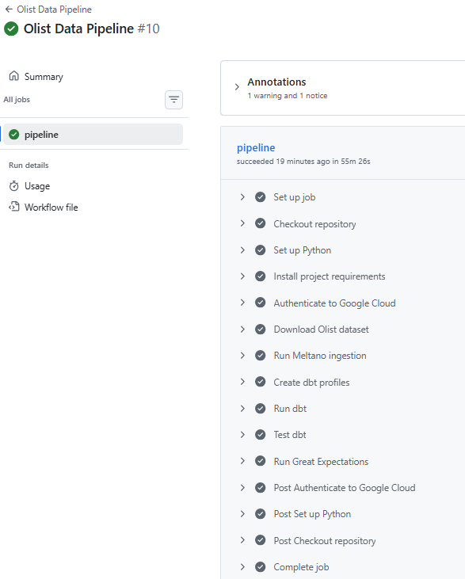
AUTOMATED DATA PIPELINE
GitHub Actions — Orchestration & Quality Gates
1. INGEST
Download Olist data → Meltano → BigQuery Raw
2. TRANSFORM
DBT → Staging → Intermediate → Marts
3. VALIDATE
Great Expectations + DBT tests
TRUSTED DATA
AUTOMATED · SEQUENTIAL · VALIDATED
Less manual work · Repeatable process · Greater confidence in data

Slide 14

Questions?
Thank you — Olist E-Commerce Data Pipeline Team

